Slide 1
Customer Churn Analysis — Telecom Industry
Predicting churn and identifying key customer segments
Priyadarshini Gupta | December 2025

Slide 2
Business Problem
Customer churn directly impacts revenue and long-term growth.
Objective:
Identify which customers are most likely to leave.
Use machine learning + customer behavior analysis to guide retention strategies.

Slide 3
Dataset Overview
7043 customer records
21 variables (demographics, services, billing, churn)
Key data cleaning steps:
Converted TotalCharges from string → numeric
Removed missing values
Encoded categorical features

Slide 4
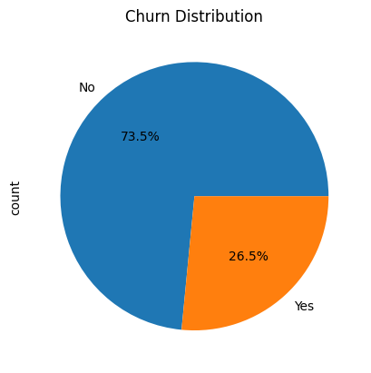
Churn Distribution
26.5% of customers have churned.
Class imbalance is present → impacts model performance.
High churn rate indicates potential service or satisfaction issues.

Slide 5
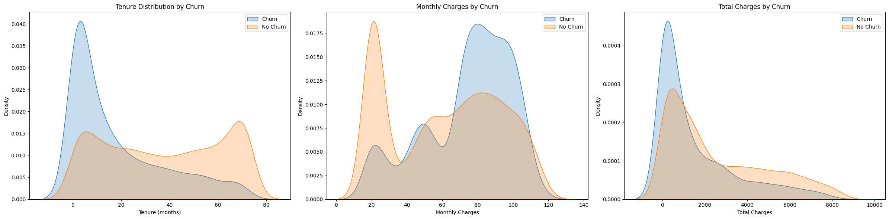
Tenure Analysis
Customers who churn tend to have much shorter tenure, mostly within the 0–12 month range.
Customers who stay (no churn) have longer and more stable tenure, with density spread across higher months.
This indicates that the first year is the highest-risk period for customer dropout.
Improving onboarding and early service experience can significantly reduce churn.

Slide 6
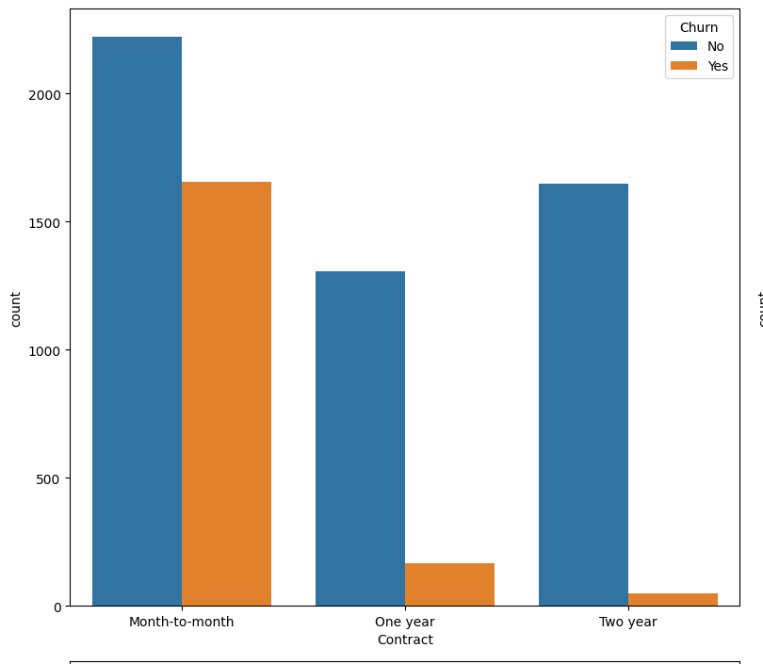
Contract Type
Month-to-month contracts show the highest churn.
One-year and two-year contract customers are significantly more loyal.
Contract structure plays a major role in retention.

Slide 7
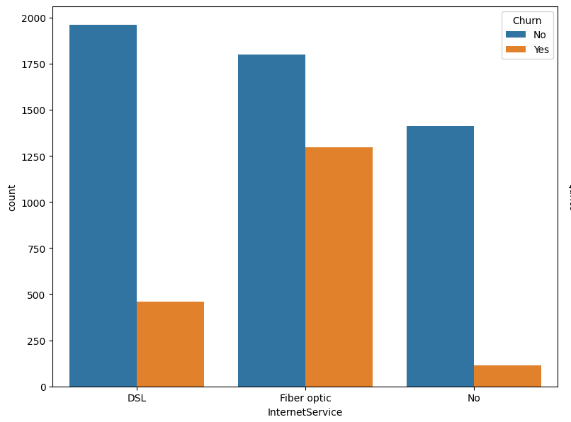
Internet Service Type
Fiber optic customers churn more than DSL users.
Could indicate performance problems, pricing concerns, or unmet expectations.

Slide 8
Billing & Charges Analysis
MonthlyCharges
Customers with higher MonthlyCharges show higher churn density.
This may indicate pricing sensitivity among short-tenure or fiber-optic users.
TotalCharges
Churned customers have much lower TotalCharges overall.
This is expected because customers who churn leave early, so they have not accumulated many charges.
Therefore, lower TotalCharges reflect short tenure, not dissatisfaction with billing.

Slide 9
Model Used
Logistic Regression (Supervised Classification)
Features (X): All customer attributes
Target (y): Churn
Train-test split: 80% / 20% (stratified)
Preprocessing: Encoding + scaling
Goal: Predict churn probability for each customer

Slide 10
Model Performance
The model predicts customer behavior with 80% accuracy, making it a reliable first version for churn identification.
When the model flags a customer as high-risk, it is correct about 65% of the time (precision).
The model captures over half of the customers who are about to leave (recall = 57%).
This provides a strong starting list of at-risk customers for targeted retention efforts.
The model currently performs better at detecting loyal customers than detecting churners.
Accuracy: 80.38%
Precision: 64.9%
Recall: 56.95%
F1 Score: 60.68%
Confusion Matrix
 | Predicted No | Predicted Yes
Actual No | 918 | 115
Actual Yes | 161 | 213

Slide 11
Feature Importance
Feature | Coefficient | Importance
tenure | -1.346313 | 1.346313
InternetService_No | -1.209062 | 1.209062
Contract_Two year | -0.895332 | 0.895332
InternetService_Fiber optic | 0.757922 | 0.757922
TotalCharges | 0.634431 | 0.634431
Contract_Month-to-month | 0.496268 | 0.496268
PhoneService | -0.474871 | 0.474871
OnlineSecurity | -0.398206 | 0.398206
TechSupport | -0.356310 | 0.356310
MultipleLines | 0.334569 | 0.334569
StreamingTV | 0.315622 | 0.315622
PaymentMethod_Bank transfer (automatic) | -0.293342 | 0.293342
PaperlessBilling | 0.291366 | 0.291366
StreamingMovies | 0.287533 | 0.287533
Contract_One year | -0.267116 | 0.267116
MonthlyCharges | -0.258057 | 0.258057
PaymentMethod_Credit card (automatic) | -0.250908 | 0.250908
Dependents | -0.232128 | 0.232128
PaymentMethod_Mailed check | -0.216015 | 0.216015
InternetService_DSL | -0.215041 | 0.215041
SeniorCitizen | 0.191609 | 0.191609
OnlineBackup | -0.157582 | 0.157582
PaymentMethod_Electronic check | 0.094084 | 0.094084
DeviceProtection | 0.046758 | 0.046758
Partner | -0.025913 | 0.025913
gender | -0.025546 | 0.025546
What Drives Customers to Leave (Positive Coefficients lead to Higher Churn)
Fiber Optic Internet: Customers on fiber plans churn more, likely due to higher pricing or inconsistent service quality.
Month-to-Month Contracts: Lack of commitment makes it easy for customers to leave anytime.
Higher Total Charges: Customers with large bills feel “cost pressure.”
Paperless Billing: Often linked with digital-first customers who switch providers more easily.
Streaming Services (TV/Movies): Add-ons may increase cost, leading to dissatisfaction or cancellations.
What Keeps Customers Loyal (Negative Coefficients leads to Lower Churn)
Long Tenure: The longer a customer stays, the less likely they are to leave.
Tech Support Enabled: Customers receiving tech support remain satisfied and loyal.
Online Security Services: Value-added protection improves retention.
Phone Service Active: A traditional, reliable service keeps customers tied in.
Two-Year Contracts: Long-term commitments significantly lower churn.

Slide 12



Customer Segmentation
Segment 1: At-Risk Customers
Month-to-month contract
Fiber optic users
High MonthlyCharges
Tenure less than 12 months
Segment 2: Loyal Customers
One-year or two-year contracts
Lower and stable charges
Long tenure
Use mailed billing methods
Segment 3: Neutral / Mid-Risk
Mid-tenure customers
DSL internet
Moderate monthly charges

Slide 13
Recommendations
Reduce churn among Month-to-Month customers
Introduce 3-month and 6-month mini-contracts as a softer upgrade path
Offer limited-time discounts for switching to annual contracts
Address Fiber Optic dissatisfaction
Investigate common complaints (speed drops, outages)
Provide proactive service checks for long-tenure fiber users
Improve security & support adoption
Bundle Online Security + Tech Support at a small combined discount
Auto-include in first 2 months and convert later with a reduced rate
Fix churn driven by Electronic Check users
Encourage shift to automatic payments (Bank Transfer / Credit Card)
Offer small incentives like: “₹50 cashback on first auto-pay activation”
Strengthen loyalty for early-tenure customers (< 12 months)
Introduce Onboarding Care Calls in the first 3 months
Provide a “Welcome Pack” with data add-ons / OTT trial
Trigger early retention offers before month 6

Slide 14
Conclusion
Logistic Regression achieved ~80% accuracy in predicting churn.
Identified major churn drivers: tenure, contract type, billing, and internet service.
Delivered clear customer segments and actionable strategies.
Implementing recommendations can significantly improve customer retention.

